Slide 1

Alex Keselman (Supervisor)
Pavel Golikovski
Alla Davydov
Alpha
MULTIPURPOSE CRYPTOCURRENCY WALLET GOOGLE CHROME EXTENSION
CAPSTONE PROJECT PHASE 1
22-1-D-1
Notes:
Alla:
Hello everyone, today we want to present our project that deals with cryptocurrency, blockchain tech and UX

Slide 2
Table of contents
Background and Research
Centralized Services
Decentralization
Ethereum Blockchain
Decentralized Finances
User Experience
Solution Proposal
Architecture
Verification Plan
Future Challenges
Notes:
Alla:
Now I will present quickly the topics 1. First We will talk about background for understanding the principles and terms 2. Than we over view the user-experience, that motivate us to create the solution and as a result to the product.
3. And after we talk why and how we make the product
4. Demonstrate the architecture of the ALPHA (OUR APP) AND examples which was completed.
5. AND FINALLY explain our Verification plan and FUTURE Challenges.

Slide 3

Centralized Systems
Centralized Systems ➜ Decentralization ➜ Blockchain ➜ ⋯
Most systems and services today are centralized. All data is stored in one object, and you must interact exclusively with this object to get the information you need. Being an easy target for potential hackers, updating a centralized system will stop the entire system, and shutting down at a centralized facility means no information is available.
For example: banks, insurances, the stock market
Notes:
Alla:
Lets start with the most popular, namely a CENTRALIZED SYSTEM. Today actually the most system and services are centralized like: a banks, Insurance companies, medical centers, databases , and so on!
That means all data stored in one place and we all must to interact exCLUsively with this object to get the information or transfer money. It’s a easy target and potential way for hackers.

Slide 4
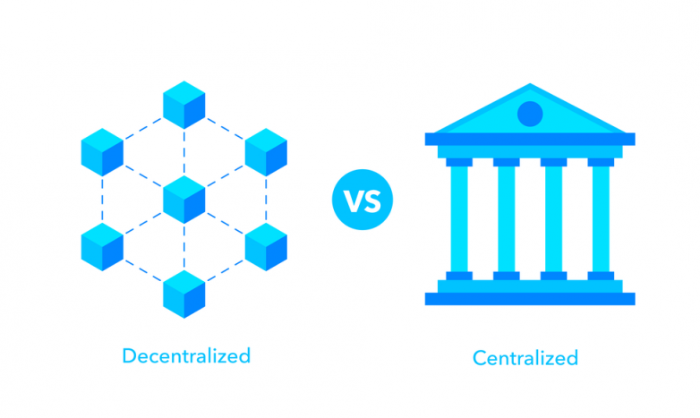
Decentralization
Centralized Systems ➜ Decentralization ➜ Blockchain ➜ ⋯
In a decentralized system, all data is distributed, so these vulnerabilities do not pose a threat. Also, in a decentralized system, no third party is required for interaction.
A decentralized system is an interconnected information system where no single entity is the individual authority. In the context of computing and information technology, decentralized systems usually take the form of networked computers.
Notes:
Alla
ON THE OTHER HAND: In a decentralized system, all data is distributed, therefore it is not a sensitive to networks attacks anymore.
A decentralized system is an inter-connected information system where no single entity is the individual authority.
Also in decentralized system we have no third party for interaction between each other.
Now every one can control their own actions and data.
(LIKE,MAKE A TRANSUCTIONS BETWEEN FINACES ACCOUNTS).

Slide 5
Blockchain
Blockchain ➜ Blocks and Mining ➜ Currency ➜ Keys ➜ Wallets ➜ Ethereum ➜ ⋯
A blockchain, is an ever-growing list of records, called blocks, that are linked through cryptographic means. Each block contains the cryptographic hash of the previous block, a timestamp, and transaction data. It is a database of transaction records that is distributed, verified and maintained by a decentralized network of computers around the world, which means it works like a peer-to-peer network.
Invented by Satoshi Nakamoto back in 2008.
Protocols are open-source and available to everyone
Uses Bitcoin as its currency
Automated and fair
Low transaction fees
Limited in functionality
Notes:
Alla:
Blockchain was invented by Satoshi Nakamoto in 2008, and he implemented the idea of decentralized concept. A blockchain, is an ever-growing list of records, called blocks.
This blocks connected via cryptographic way. Than, each block contains the cryptographic hash of the previous block, a times-tamp, and transaction data.
!! Basically blockchain, It is a database of transaction- records that is distributed and works likes peer-to-peer network. !!
Look at THE FLOW GRAPH OF MAKING TRANSACTION:
Transactions is Created- > send to every nodes -> validated -> the transaction added to the blockchain -> and update is distributed cross the network!
Full version:
A transaction is authenticated -> a block representing that transaction is created -> the block is send to every node in the blockchain->nodes validate the transaction -> the block is added to the existing blockhain –>node receive a reward for Proof of Work , typically in cryptocurrency -> THE update is destributed across the network -> The transaction is completed.
>

Slide 6
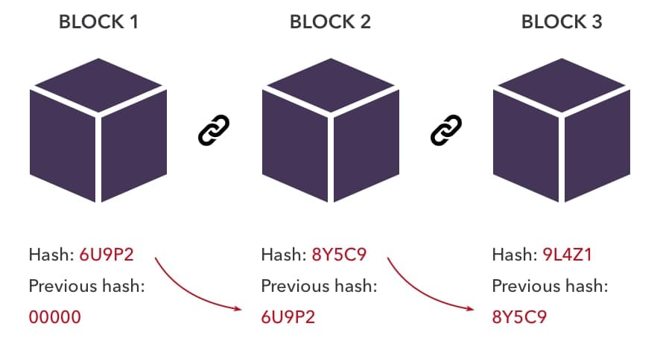
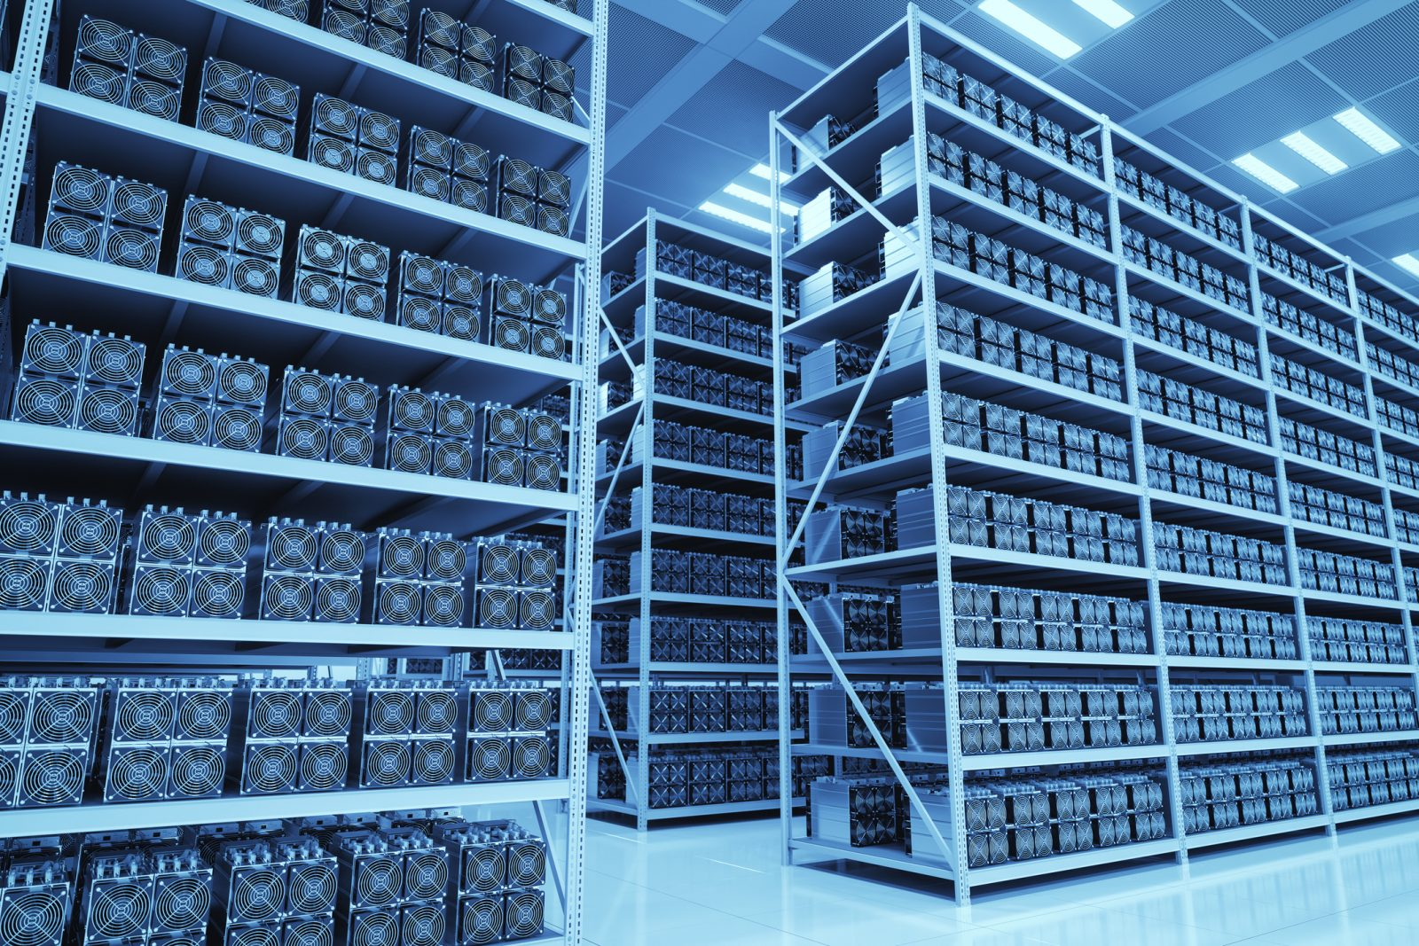
Blocks and Mining
Blockchain ➜ Blocks and Mining ➜ Currency ➜ Keys ➜ Wallets ➜ Ethereum ➜ ⋯
Mining is the process of creating a block of transactions that will be added to the Blockchain.
Miners often use GPUs to solve difficult algorithmic problems over long periods to produce new blocks using a concept of Proof of Work – the amount of work they’ve put to generate the block and thus rewarded for it.
In decentralized systems like Ethereum, we need to make sure everyone agrees on the order of transactions. Miners help with this by solving computationally complex block-building puzzles, protecting the network from attacks.
Notes:
Alla:
*Mining is the process of creating a block of transactions that will be added to the blockchain.*
*Miners often use GPUs to solve difficult algorithmic problems over long periods to produce new blocks using a concept of Proof of Work* ,actually ,
Each miner provides a mathematical proof when submitting a block to the blockchain, and this proof acts as a guarantee: if the proof exists, the block must be valid!
And than - The amount of work they have put to generate the block and thus rewarded (PAYMENT) in cryptocurrency for it.

Slide 7
Cryptocurrency
Blockchain ➜ Blocks and Mining ➜ Currency ➜ Keys ➜ Wallets ➜ Ethereum ➜ ⋯
A cryptocurrency (or “crypto”) is a form of payment that can circulate without the need for a central monetary authority such as a government or bank. Instead, cryptocurrencies are created using cryptographic techniques that enable people to buy, sell or trade them securely.
Cryptocurrencies can be exchanged for goods and services, though they often are used as investment vehicles. Cryptocurrency is also a key part of the operation of some decentralized financial networks, where digital tokens are an important tool for carrying out transactions.
The global crypto market cap is $1.96 trillions.
The total crypto market volume over the last 24 hours is $92.70 billions. (9.01.2022)
The total volume in DeFi is currently $16.30 billions, 17.58%.
Notes:
Pavel

Slide 8
Key-based Assets
Blockchain ➜ Blocks and Mining ➜ Currency ➜ Keys ➜ Wallets ➜ Ethereum ➜ ⋯
Crypto-assets only ever live in the form of addresses and keys on the Blockchain.
A private key is a secret number that is used in cryptography, similar to a password. In cryptocurrency, private keys are also used to sign transactions and prove ownership of a blockchain address.
A public key, on the other hand, is a known-to-all key by which transactions and public information can be traced.
For example, Bitcoin uses the ECDSA (Elliptic Curve Digital Signature Algorithm) with a particular secp256k1 curve.
Notes:
Pavel

Slide 9
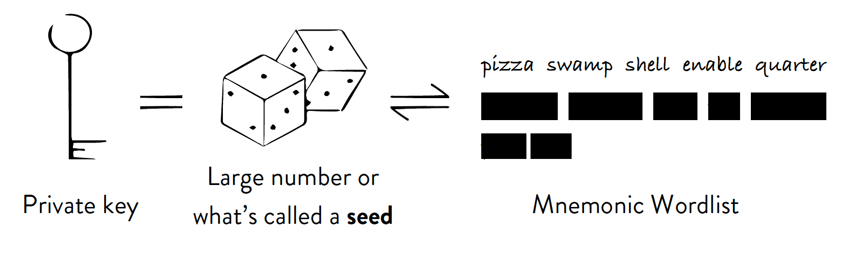
HD Wallets
Blockchain ➜ Blocks and Mining ➜ Currency ➜ Keys ➜ Wallets ➜ Ethereum ➜ ⋯
Hierarchical Deterministic wallets, like simple deterministic wallets, are created from a single master root seed, usually represented by a mnemonic word sequence (12-24 words), which makes it easier for account holders to transcribe and store. But HD wallets also offer the option of creating public keys without having to access the corresponding private keys. This means they can be used on insecure servers or in a receive-only mode.
Our project is a type of a HD wallet with extra functionality.
Notes:
Pavel

Slide 10
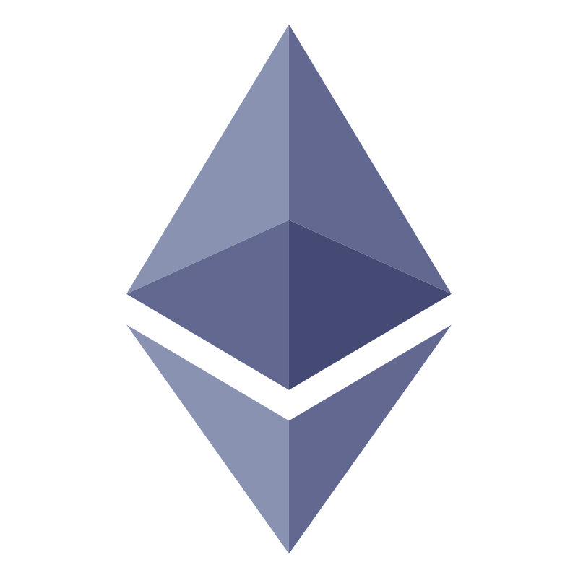
Ethereum Blockchain
Ethereum ➜ Smart Contracts ➜ DeFi ➜ Problem ➜ ⋯
The Blockchain is a powerful technology both in concept and implementation, but could it be further improved?
The Ethereum Blockchain is an open source, decentralized blockchain with smart contract functionality. Ether (ETH) is the cryptocurrency of the Ethereum network. The network allows developers to build and deploy decentralized applications
Conceived by Vitalik Buterin back in 2013, released in 2015
Programmable
Smart Contracts
Dynamic fees
Faster mining and confirmations
Notes:
Pavel

Slide 11
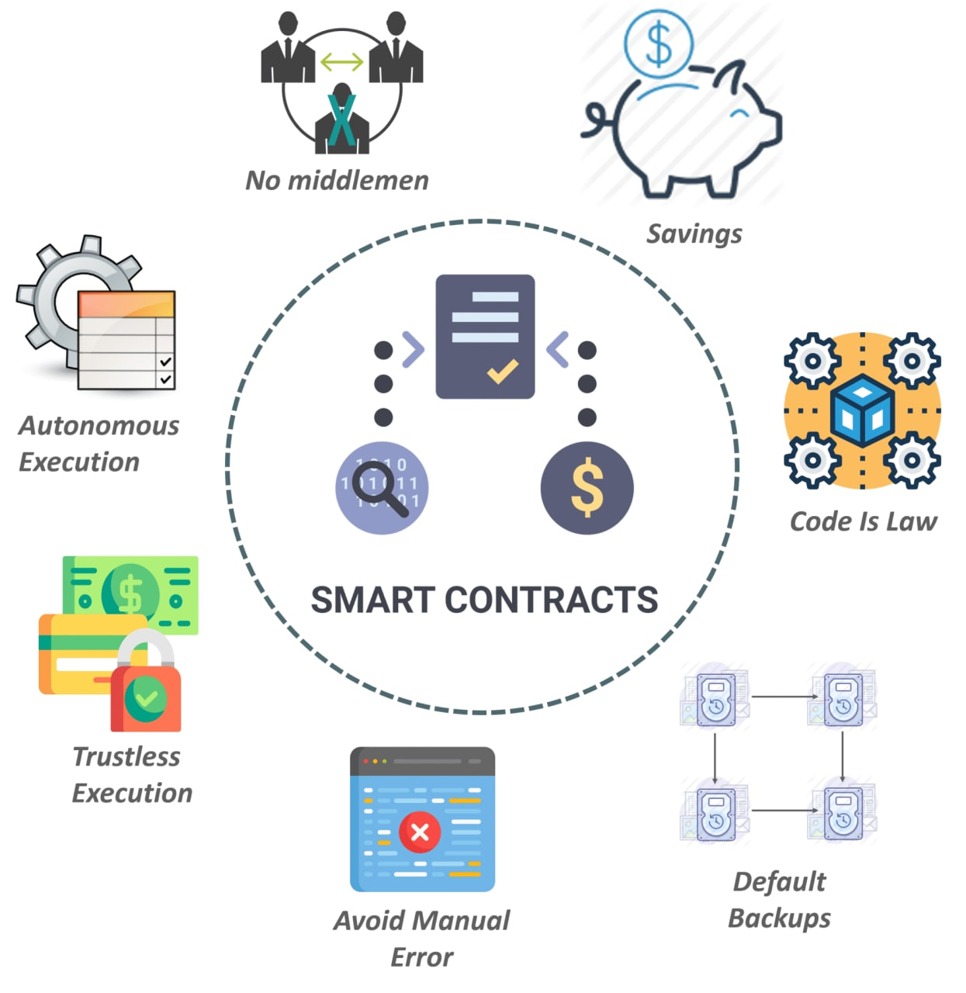

Smart Contracts
Ethereum ➜ Smart Contracts ➜ DeFi ➜ Problem ➜ ⋯
Smart contracts are code scripts that facilitate the exchange of money, stocks, content, or anything of value. Smart contracts are formed using the Ethereum Virtual Machine (EVM) and are written in the Solidity language.
Decentralized Apps (Dapps) are open-source software using smart contracts and do not need an intermediary to operate.
Notes:
Pavel

Slide 12
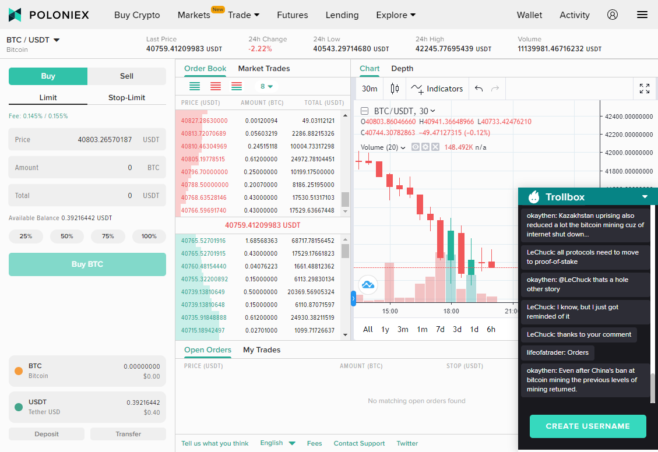
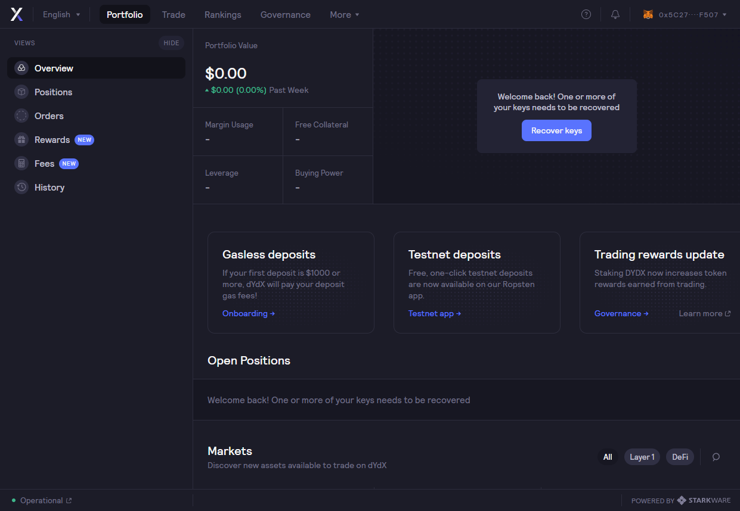
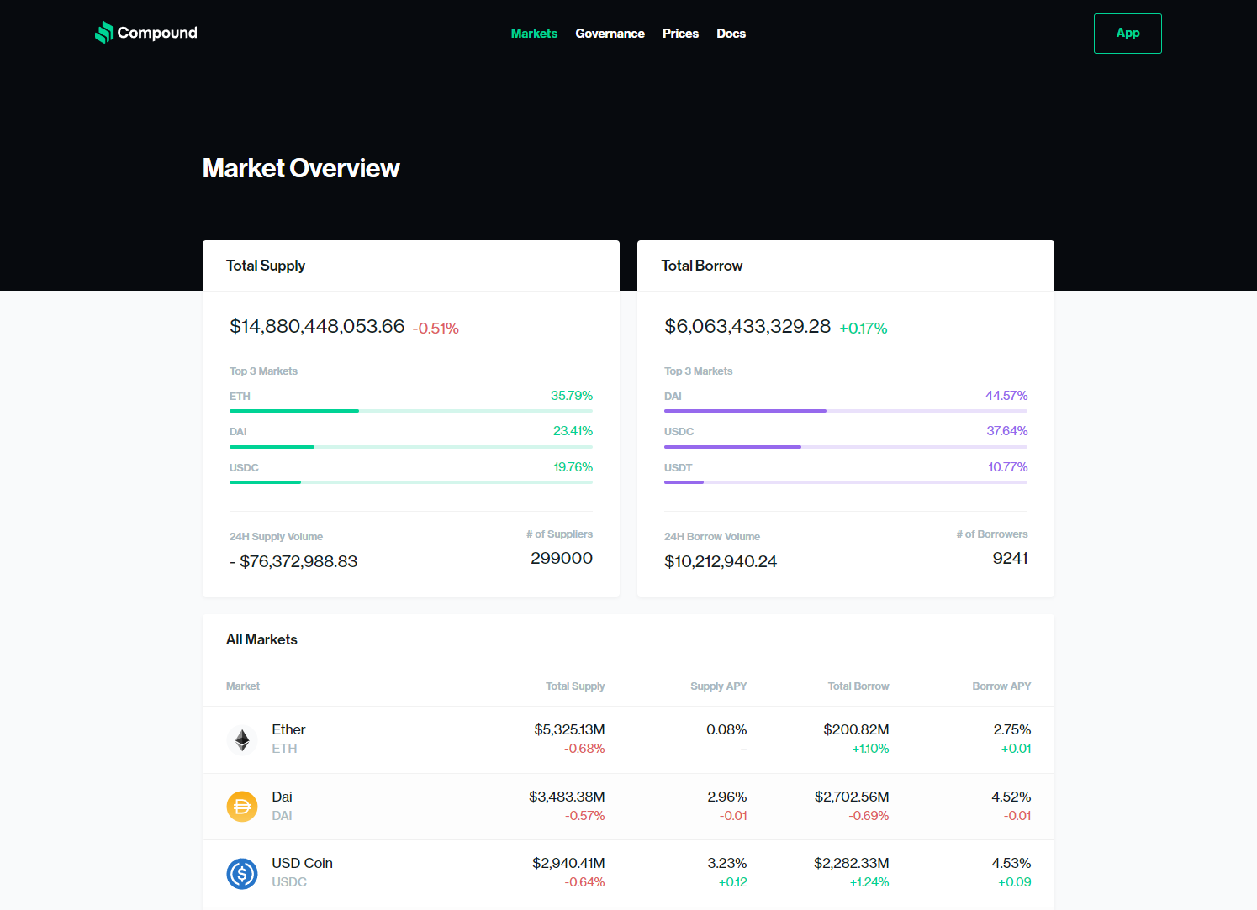
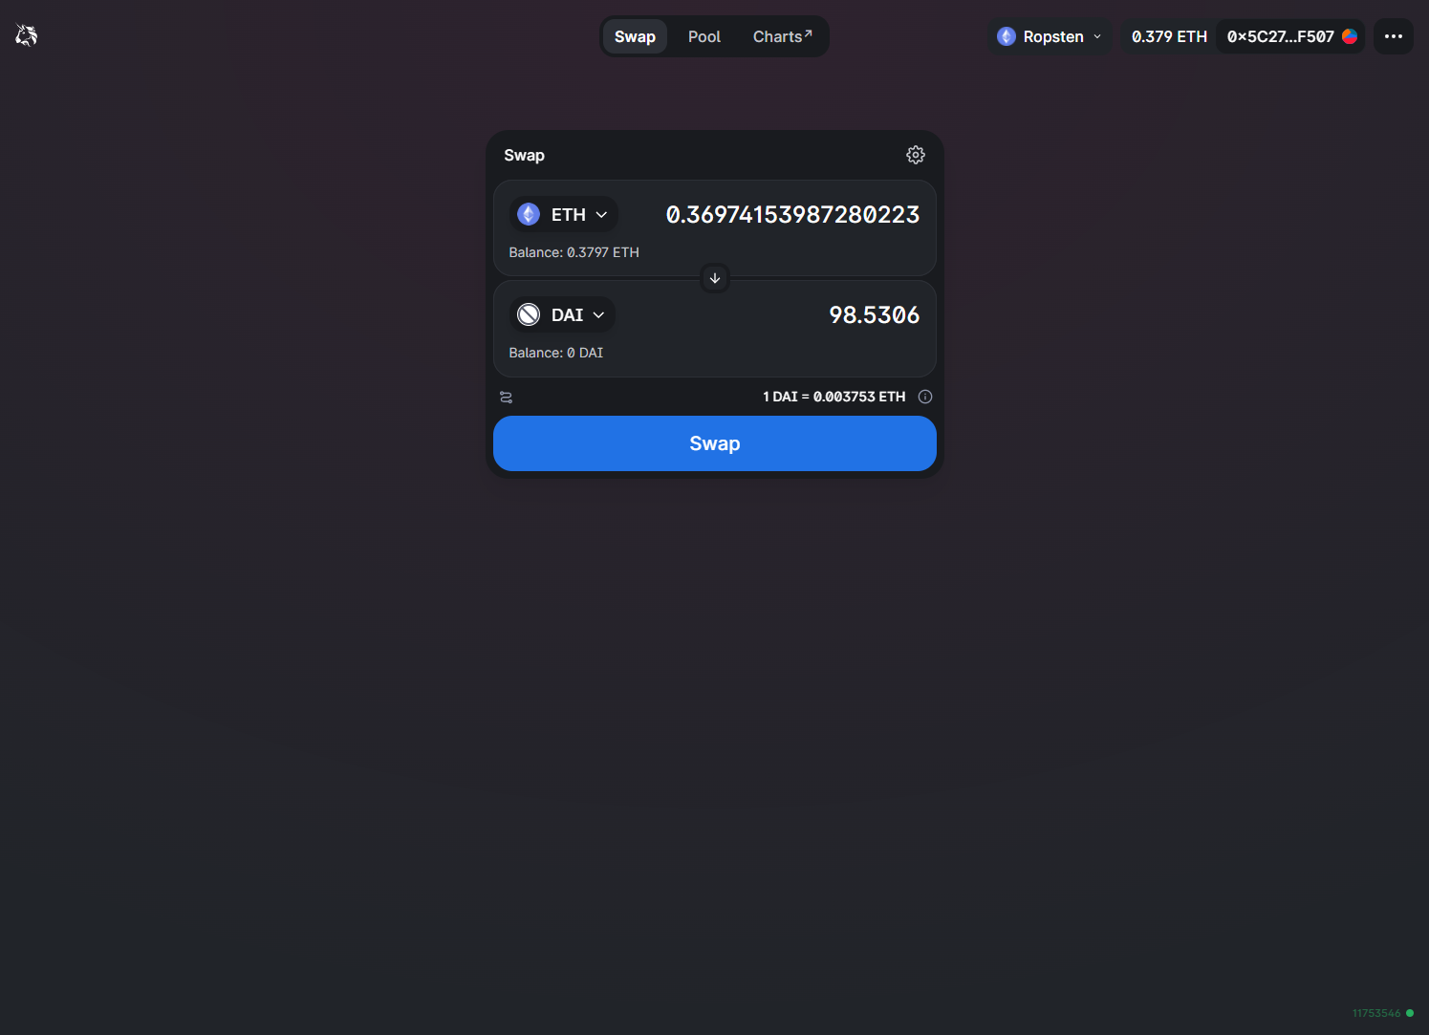
Decentralized Finances (DeFI)
Ethereum ➜ Smart Contracts ➜ DeFi ➜ Problem ➜ ⋯
DeFi is currently one of the fastest growing sectors in the Blockchain and cryptocurrency space. It is an ecosystem of decentralized applications that provide financial services built on decentralized networks without any governing authority.
The DeFi sector is a collection of products and services that replace various institutions, including banking, insurance, bonds, and money markets. These financial services are delivered through decentralized applications, allowing users to combine their services (such as borrowing, lending and trading) to unlock many possibilities.
Notes:
1. All finances are based on smart-contracts that Pavel explained , Thanks to smart contract defi were created.
2. * DeFi is currently one of the fastest growing sectors in the Blockchain and cryptocurrency space,
It is an ecosystem of decentralized applications that provide financial services built on decentralized networks without any authority.*
3. As you can see there are many different types of defi serveces:….!!
4. And in addition to the regular user it seems little scary the amount of information he see in any such service! The bad user experience of a is really problem

Slide 13
Progress
is
A
UX
Problem
Fear of the unknown
Steep learning curve
Time consuming
Good User Experience
Notes:
Alla:
okey, as I said AND WE SEE BEFORE. EXAMPLES OF BAD UX, SO we think ,User experience prevents ( stops) people from switching from traditional finance to cryptocurrency because of : FEAR OF THE UNKNOWN, STEEP LEARNING CURVE (MANY NEW CONCEPTS), TIME CONSUMING. All this can be solved with the GOOD UX!!!

Slide 14
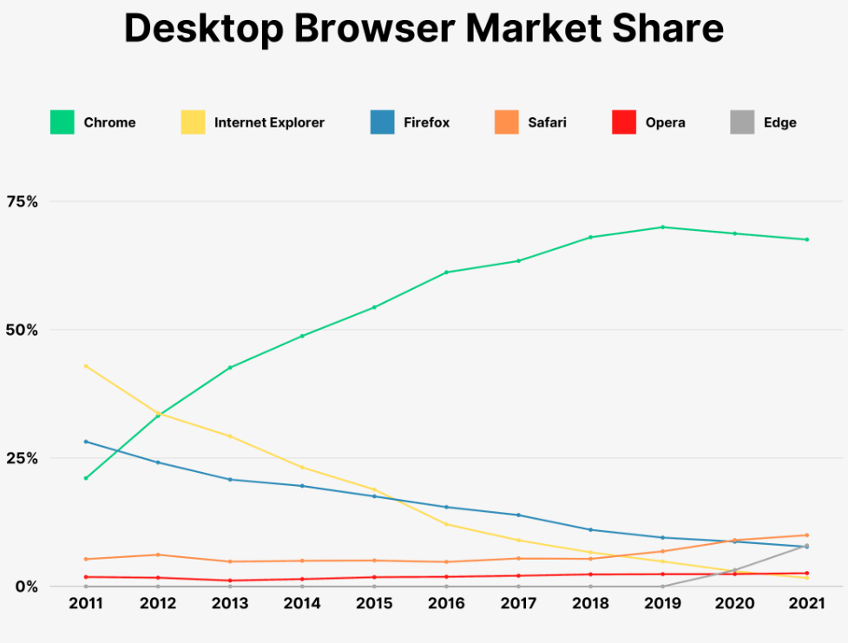

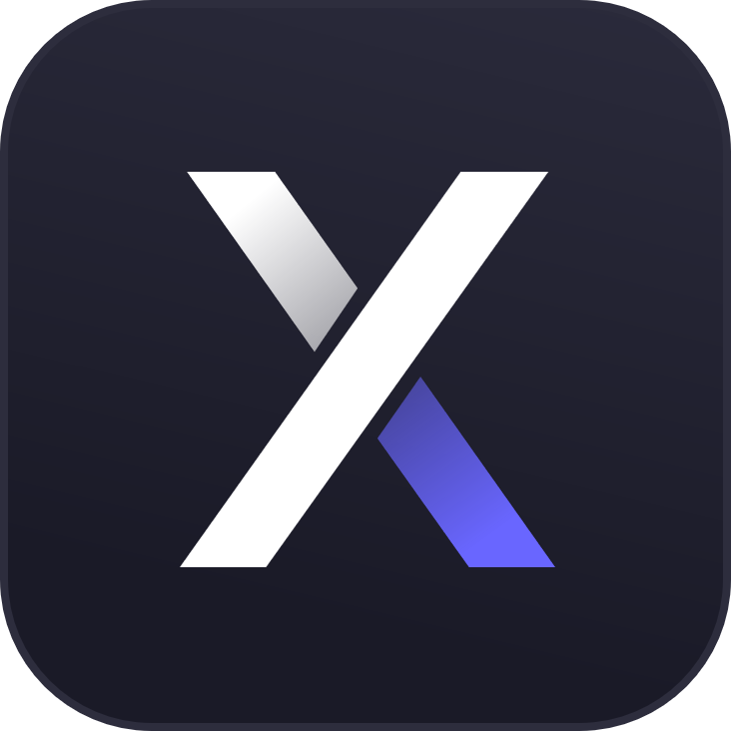



Solution – Multipurpose HD Wallet Extension
Why a Chrome extension?
HD Wallet
Truly Serverless
Popular
Modern
Fast
Multiple DeFi services in a single application
Uniform, user-friendly design
Built-in simple guidelines and tutorials
Modular and extensible
Extensions are locally stored, use Chrome’s V8 engine to run
Actions can be cached offline and executed later
External web APIs
V8 Engine
Local
Notes:
Pavel

Slide 15



AESTHETIC-USABILITY EFFECT
HICK’S LAW
LAW OF SIMILARITY
Users often perceive aesthetically pleasing design as design that’s more usable.
The time it takes to make a decision increases with a the number and complexity of choices.
The human eye tends to perceive similar elements in a design as a complete picture, shape, or group, even if those elements are separated.
Notes:
Pavel

Slide 16
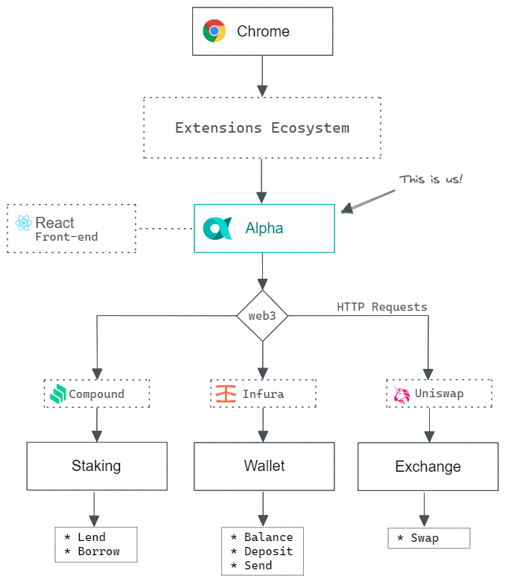
Architecture
Using Chrome as the backbone of our project, we are developing our extension with the React JS frontend using Semantic UI components to ensure uniform design across the application.
To interface with Blockchain and various DeFi services our extension will use HTTP requests as well as Web Sockets to provide smooth and real-time user experience using web3.js libraries.
As a starting point, we plan on implementing currency exchange service using Uniswap API, staking service using Compound API and the basic Blockchain functionality using Infura API.
Notes:
Pavel

Slide 17
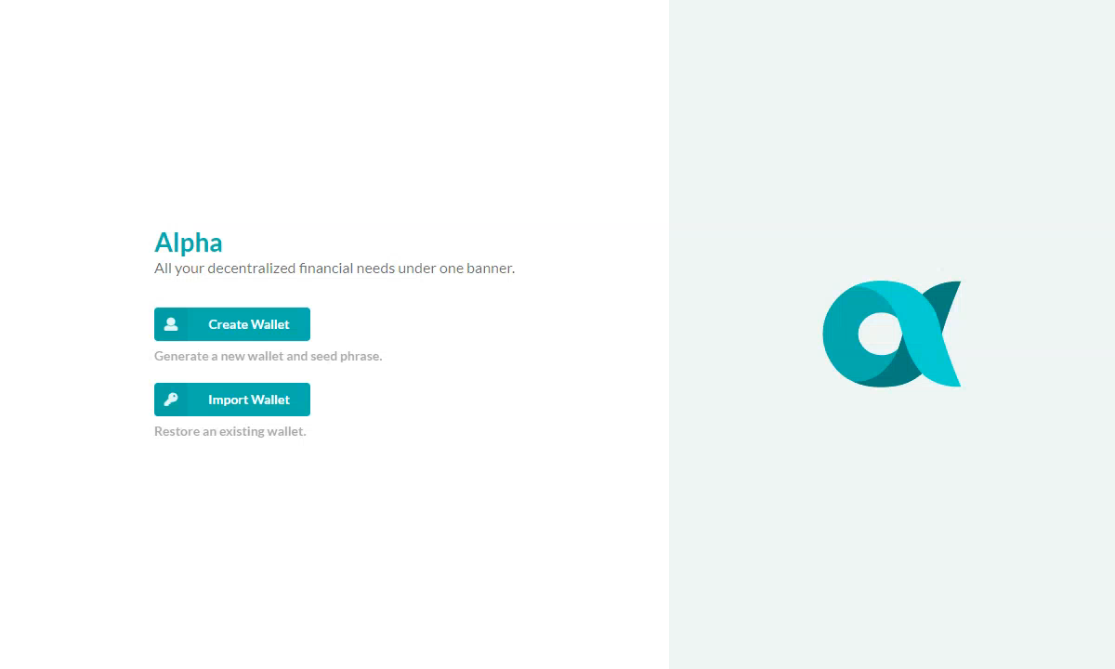
Flow // New User
Users can either create a new wallet or import an existing one using a 12-words phrase or a private key.
Notes:
Alla:
Based on all the design rules, we have created our own app and want to introduce the basic functionality of HD crypto wallet.

Slide 18
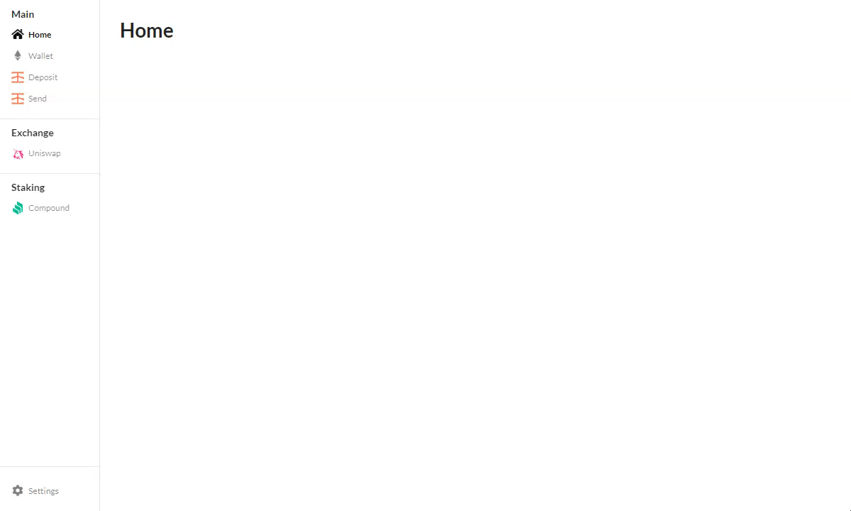
Flow // Content
Users will interact with the menu to access a user dashboard, different modules and extension settings.
Notes:
Alla
NOW- if we successfully create or import HD wallet we arrives the HOME page!

Slide 19
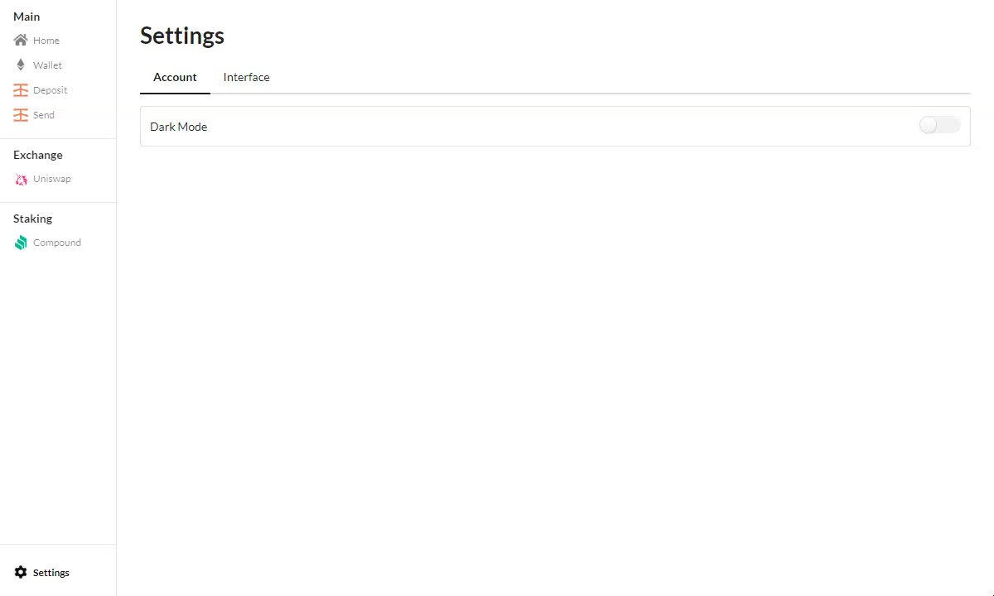
Flow // Settings
Users will be able to access and customize various settings.
Notes:
Alla
Here we can see on the one of the things into the settings option - the different modes =light and dark.

Slide 20
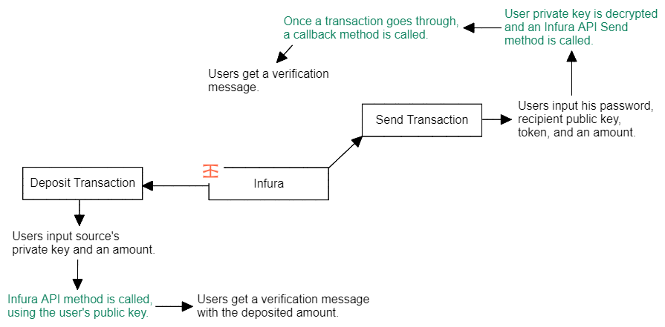
Flow // Infura
Users will be able to directly send, deposit and check their account balance using the Infura API.
Notes:
Pavel

Slide 21
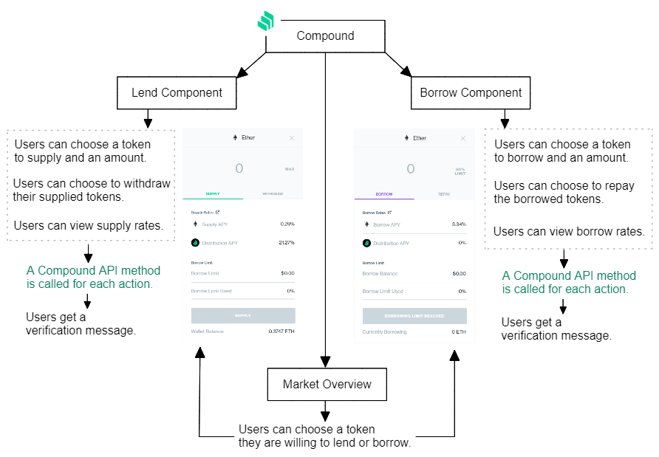
Flow // Compound
Users will be able to directly lend, borrow and check yield percentages using the Compound API.
Notes:
Pavel

Slide 22
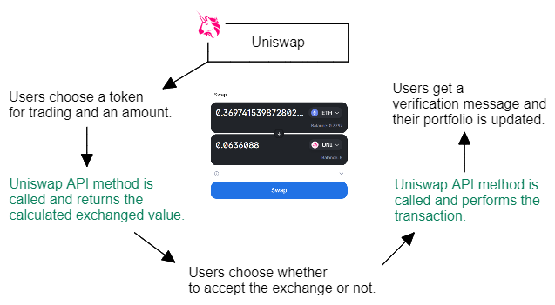
Flow // Uniswap
Users will be able to directly exchange currencies and tokens using the Uniswap API.
Notes:
Pavel

Slide 23
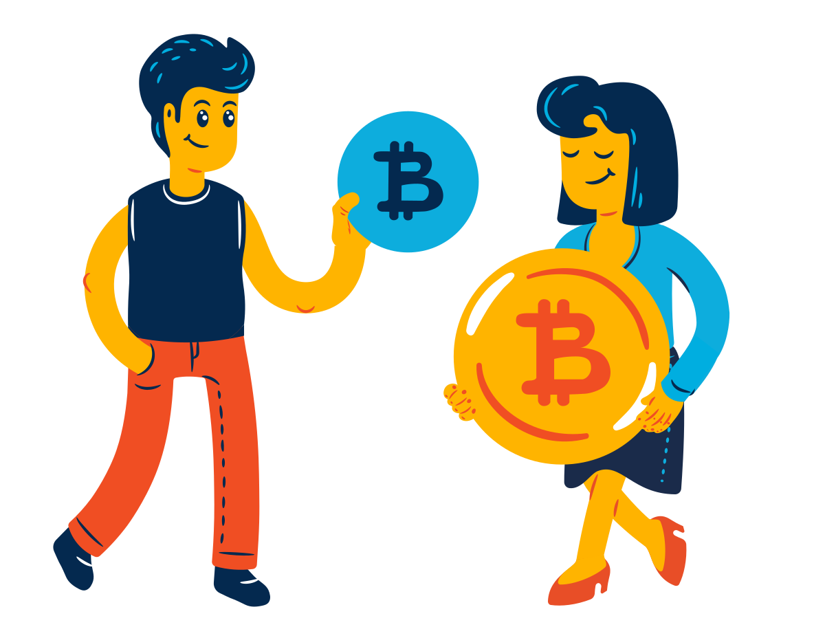

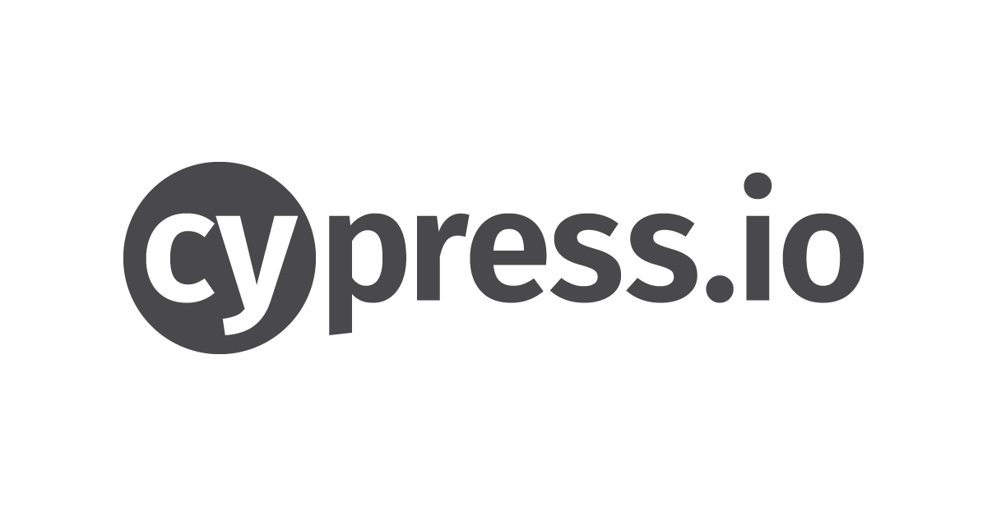
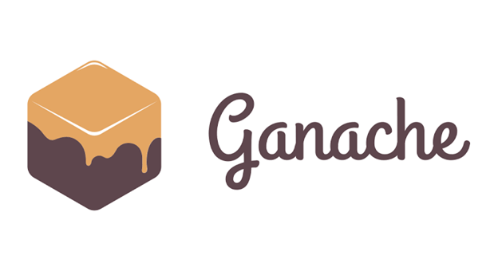
Verification and testing
Extension Level Testing
Blockchain Level Testing
Friends and Family Testing
For frontend testing, we plan on writing unit tests using JavaScript-based testing framework such as Jest or Cypress.
Few of the tests:
For backend testing, all of our API logic will run locally using Ganache Testing Suite as well as real decentralized testing networks such as Ropsten TESTNET.
Few of the tests:
If possible, we would also like to offer our extension to friends and family members to try out and give us their immediate feedback.
Mnemonic Verification
Verifications
Signature
Transaction Validation
Decryption
Encryption
User Input
Exchanged Values
Yield Rates
Notes:
Pavel

Slide 24
Challenges
We expect to face number of challenges, especially in the ever-evolving and experimental Blockchain sphere, among few others:
Blockchain is a new and massive field – big learning curve
Learning different APIs, making sure they’re up-to-date
Implementation in JavaScript and React
Using UX concepts correctly
Notes:
Pavel

Slide 25

Thank you for listening. Questions?

